Slide 1
Exploratory Data Analysis (EDA) for Real Estate Pricing
Submit by Sanchaita Biswas

Slide 2
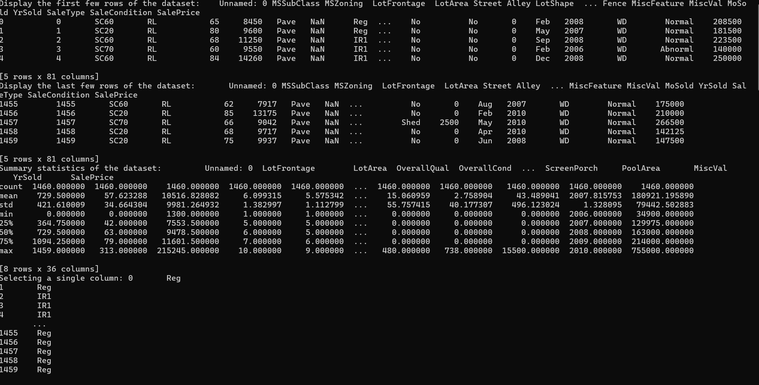
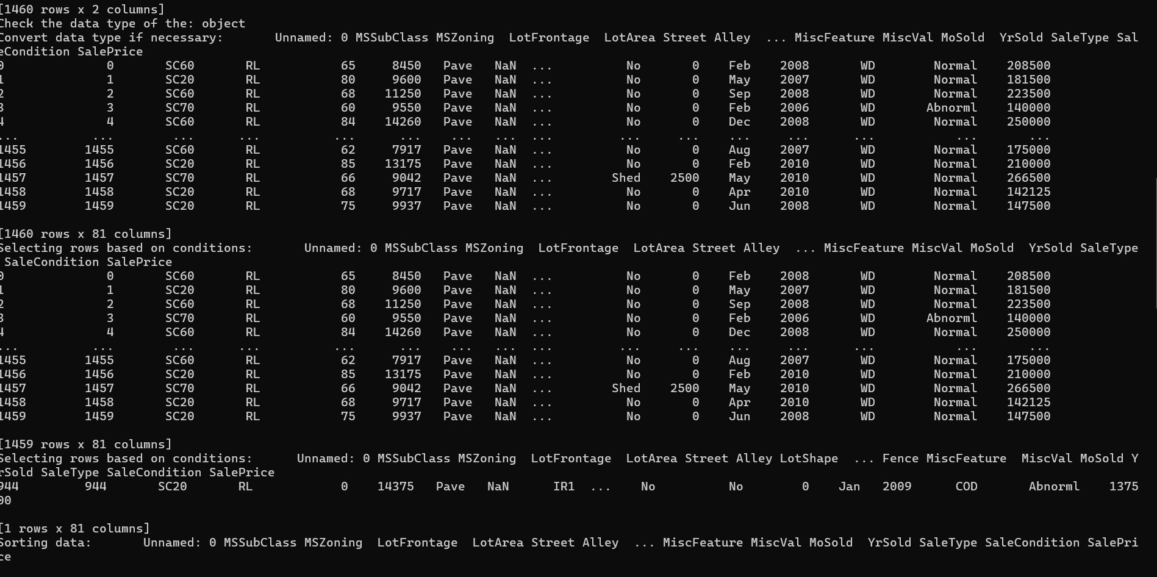
Loading the Data
Loading the Data: Loading the dataset into a Pandas Data Frame allows for easy manipulation and analysis of the data. Using the Pandas library in Python, we read the dataset from its source (e.g., CSV or Excel file) and store it in a Data Frame, which is a tabular data structure. This facilitates various data preprocessing and analysis tasks, enabling us to gain insights into the real estate pricing dataset.

Slide 3
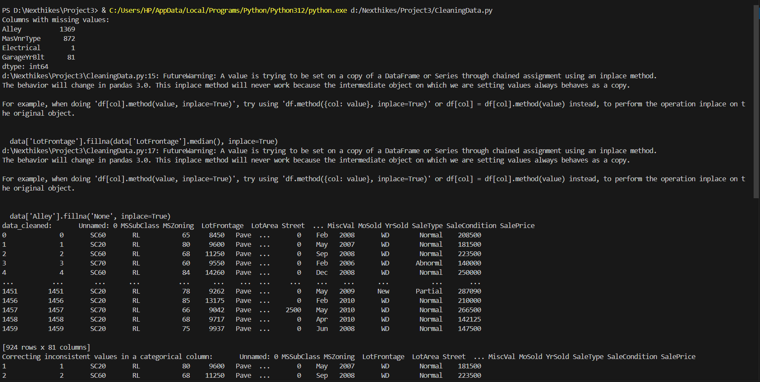
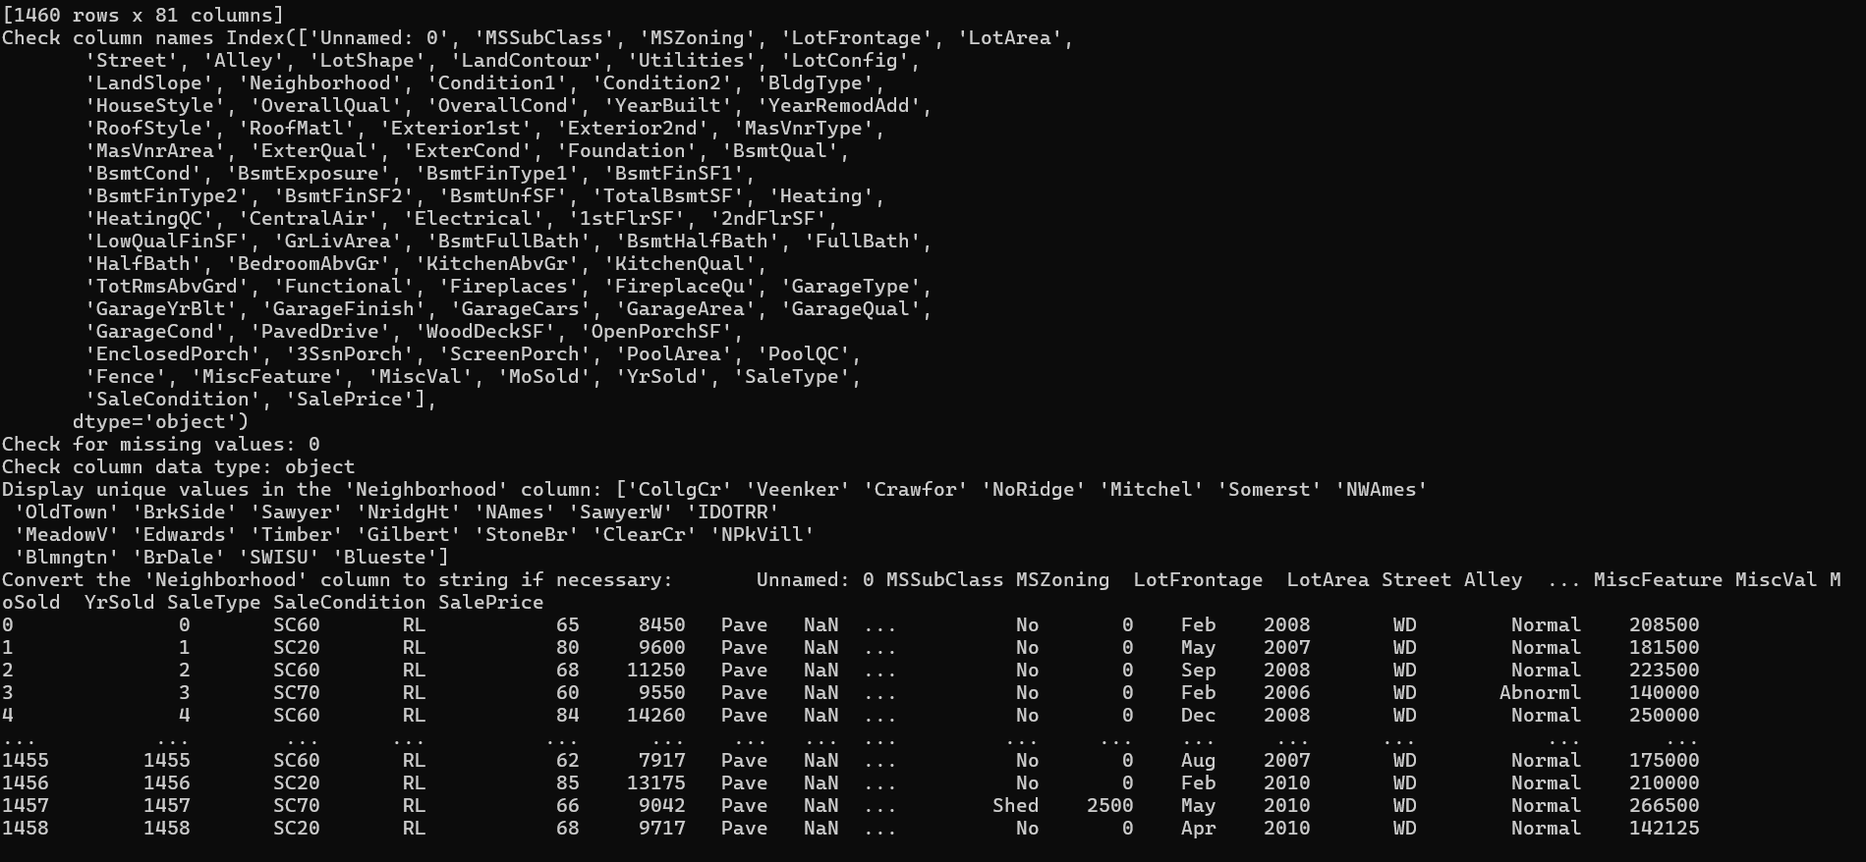
Cleaning the Data
Handling Missing Values: Handling missing values is crucial for maintaining data integrity and ensuring accurate analysis. Missing data can introduce bias and affect the reliability of our findings. By either filling in missing values with appropriate estimates or removing rows or columns with excessive missing data, we can prevent biases in our analysis. Imputation methods such as mean, median, or mode can be used for numerical data, while categorical data can be imputed using the most frequent value or a separate 'missing' category. Careful consideration of the impact of each missing value handling strategy is necessary to avoid introducing unintended biases.
Removing Duplicates: Removing duplicate entries helps in eliminating redundancy and ensuring that each observation in the dataset is unique. Duplicate entries can distort statistical analyses, leading to skewed results and inaccurate conclusions. By identifying and removing duplicate rows based on selected key attributes or columns, we can improve the reliability of our findings. It's essential to carefully define criteria for identifying duplicates to avoid unintentional removal of valid data. Techniques such as sorting the dataset or using built-in functions in Python can facilitate the identification and removal of duplicate entries efficiently.
Addressing Anomalies: Addressing anomalies or outliers is essential for maintaining the accuracy of statistical analyses. Anomalies can skew descriptive statistics, influence model performance, and lead to erroneous conclusions. Techniques such as winsorization, trimming, or employing robust statistical methods can help mitigate the impact of outliers on analysis results. Winsorization involves replacing extreme values with less extreme values, while trimming involves removing outliers altogether. Outlier detection algorithms like Z-score, IQR, or machine learning-based approaches can aid in identifying and addressing anomalies effectively. Careful consideration of the context and domain knowledge is crucial when deciding on the appropriate anomaly detection and treatment methods

Slide 4
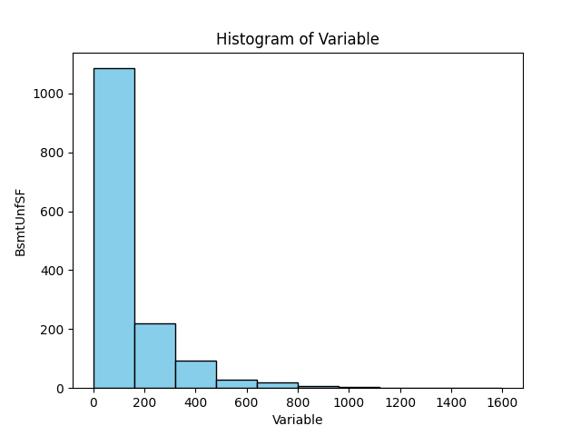
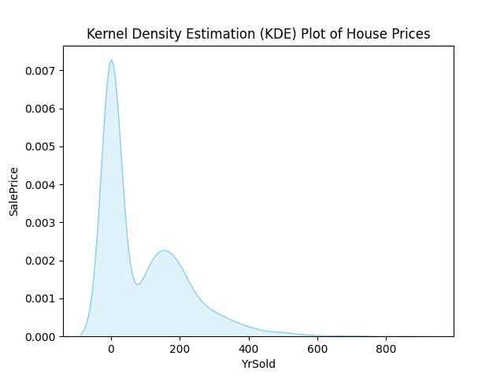
Univariate Analysis
Univariate analysis focuses on examining individual variables in a dataset to understand their distribution and characteristics. In the context of our real estate pricing dataset, this analysis provides insights into the distribution of house prices, helping us understand the range, central tendency, and spread of prices across the dataset.
This histogram (or kernel density plot) illustrates the frequency distribution of house prices within the dataset. Understanding the distribution of prices is crucial for various reasons:
Identifying Central Tendency: It allows us to identify the typical or central price range of properties in the dataset, which is valuable for setting pricing strategies or making investment decisions.
Assessing Data Quality: Univariate analysis helps in identifying outliers or unusual patterns in the data distribution, which might require further investigation or cleaning.
Informing Decision-Making: By understanding the distribution of prices, stakeholders can make informed decisions regarding buying, selling, or investing in real estate properties.
Modeling Considerations: Knowledge of the distribution of prices aids in selecting appropriate modeling techniques and understanding assumptions underlying statistical analyses.

Slide 5
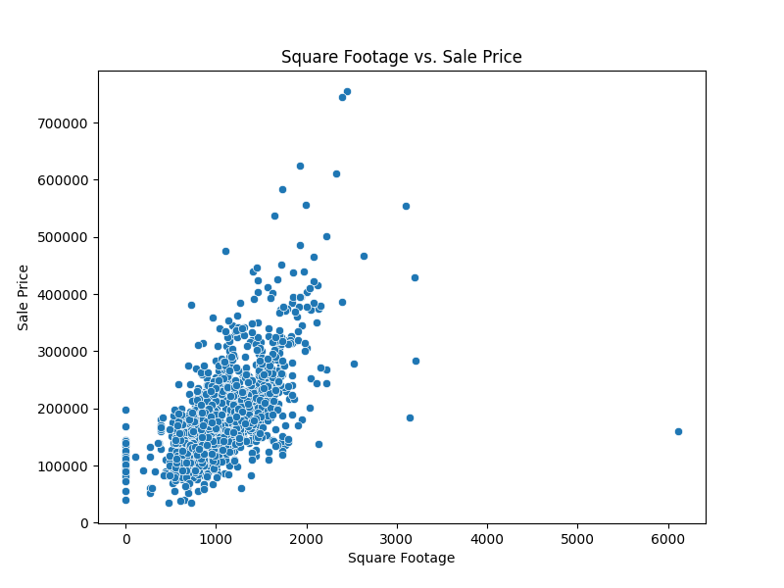
Multivariate Analysis
Multivariate Analysis: Multivariate analysis is crucial in understanding how multiple variables interact and influence each other within the dataset. The scatterplot matrix or correlation matrix visually represents the relationships between various features, shedding light on their interdependencies and correlations.
Significance:
Identifying Correlations: The correlation matrix helps identify variables that are strongly correlated with each other, which can be crucial for feature selection in predictive modeling tasks.
Understanding Dependencies: By analyzing the scatterplot matrix, we can discern patterns and dependencies between different pairs of variables, offering insights into how they jointly affect house prices.
Model Building: Multivariate analysis informs feature selection and model building processes by highlighting which variables have the most significant impact on the target variable, thereby improving the predictive accuracy of the models.
Data Interpretation: Understanding multivariate relationships allows for a more nuanced interpretation of the data, enabling informed decision-making in real estate pricing strategies and investment decisions.

Slide 6
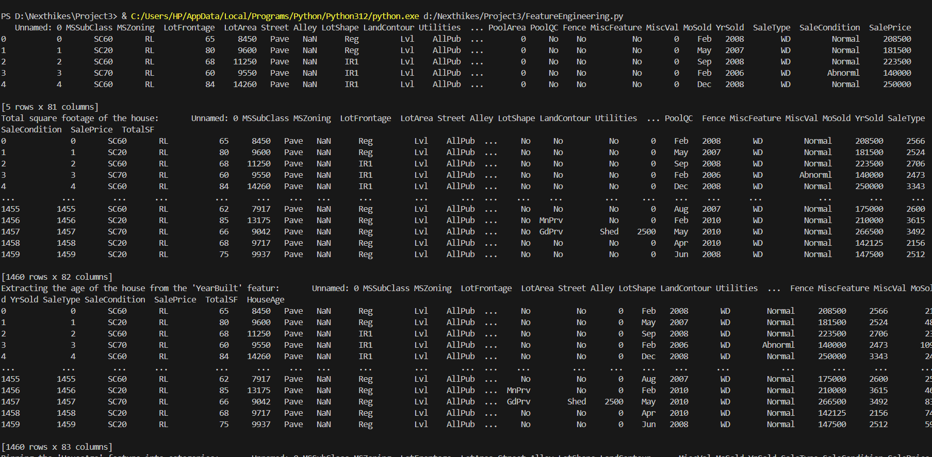
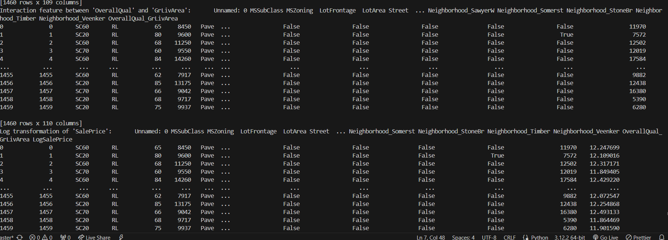
Feature Engineering
Feature Engineering: Brief explanation of feature engineering and its impact on analysis: Feature engineering involves creating new features from existing data to improve machine learning model performance or gain deeper insights into the dataset.
In this example, we calculated the price per square foot by dividing the house price by its square footage. This new feature can provide a standardized measure of price across properties of different sizes, aiding in comparative analysis.
Additionally, we engineered features like property age, which can capture the depreciation effect on house prices, and a composite score reflecting the overall condition of the property, which may influence its market value.

Slide 7

Geospatial Analysis
Geospatial analysis: involves the examination of data in relation to its geographic location. By plotting house prices on a map, we can visually discern spatial patterns and regional pricing disparities. This analysis provides valuable insights into how property values vary across different neighborhoods or areas.
Insights gained from geospatial analysis can include identifying high-value or low-value areas, understanding the distribution of prices within a city or region, and uncovering factors driving pricing discrepancies. This information is crucial for real estate market analysis, urban planning, and investment decision-making.

Slide 8
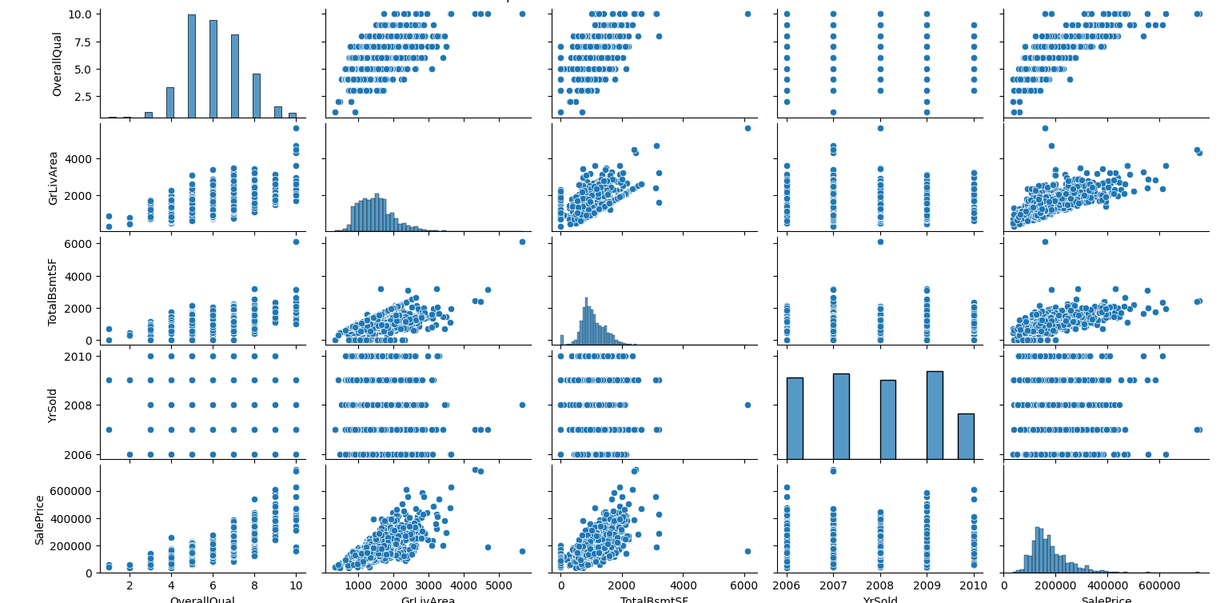
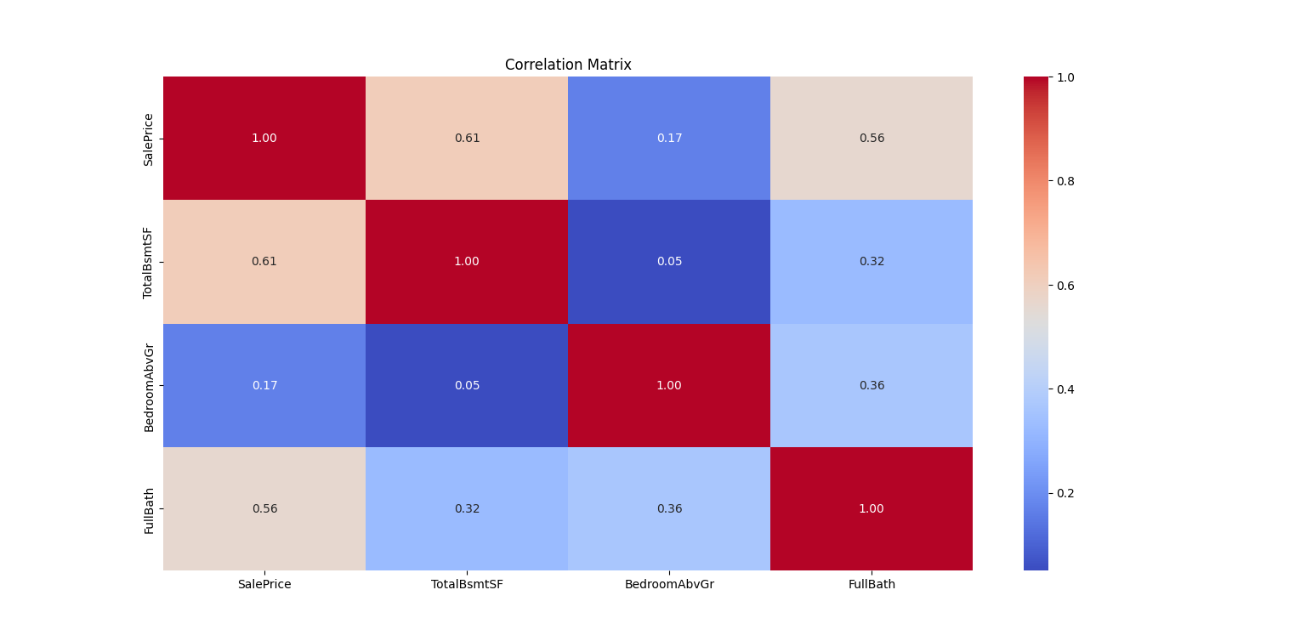
Feature Engineering and Size Impact
Feature Engineering and Size Impact : In this analysis, we delve deeper into the impact of various features, particularly house size, on house prices. The scatterplot visually demonstrates the relationship between house size and prices, providing insights into how changes in size influence property valuations. Larger properties tend to command higher prices, but the extent of this relationship may vary based on other factors such as location, amenities, and market trends. By understanding the size-price dynamics, we can better assess the value proposition of different properties and make informed pricing decisions. This analysis underscores the importance of considering not just individual features but also their interactions in determining property values.

Slide 9
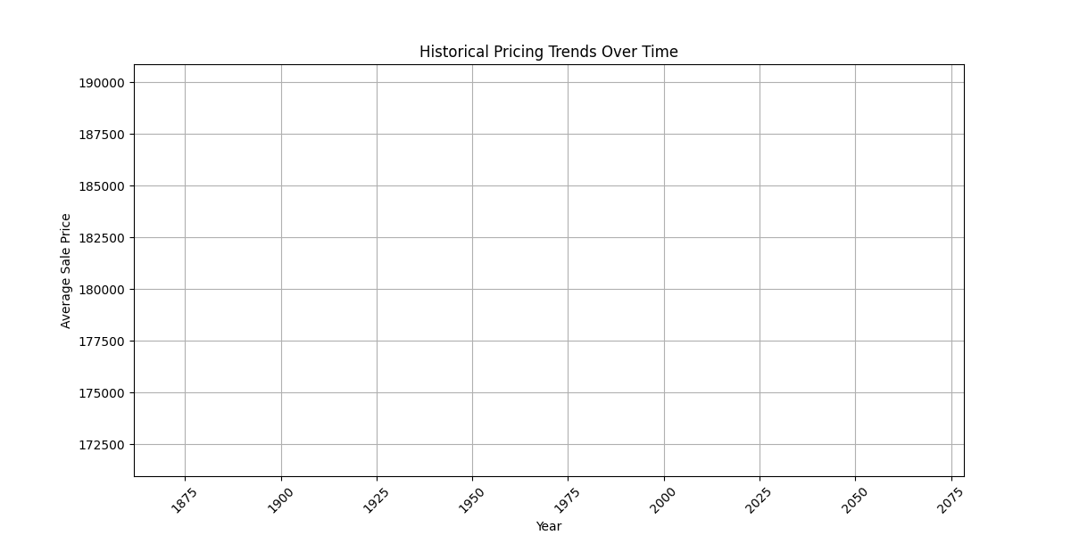
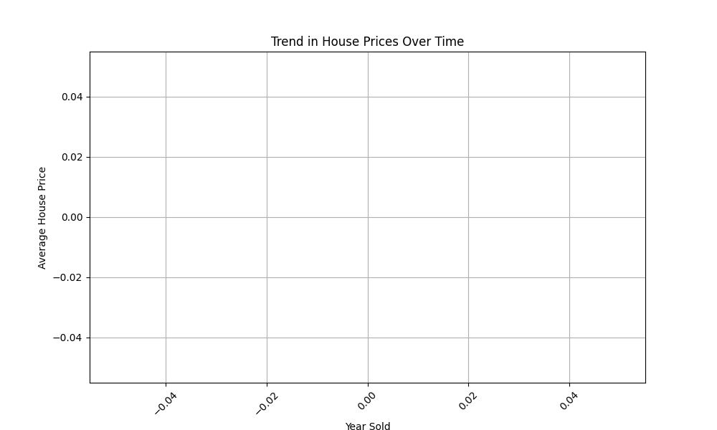
Market Trends and Historical Pricing
Introduction: Begin with an introduction to the importance of analyzing market trends and historical pricing. Mention how understanding past price movements can provide valuable insights into future market behavior.
Data Analysis: Explain the analysis conducted on the dataset to identify historical pricing trends. Mention any preprocessing steps done, such as data cleaning or filtering out outliers.
Trend Identification: Describe the trends observed in the historical pricing data. Mention whether prices have been steadily increasing, fluctuating, or experiencing other patterns over time.
Key Findings: Highlight any significant findings or insights discovered through the analysis. For example, identify periods of rapid price growth, downturns, or stability in the market.
Factors Impacting Trends: Discuss potential factors that may have influenced the observed trends, such as economic conditions, housing supply and demand, government policies, or other market dynamics.
Implications: Discuss the implications of the identified trends for various stakeholders, such as buyers, sellers, investors, and policymakers. Address how understanding historical pricing can inform decision-making in the real estate market.

Slide 10
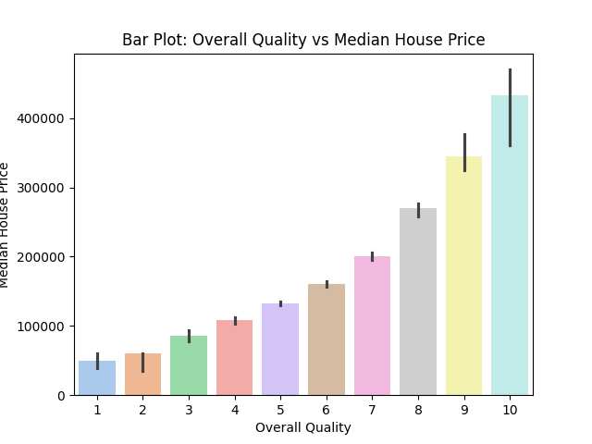
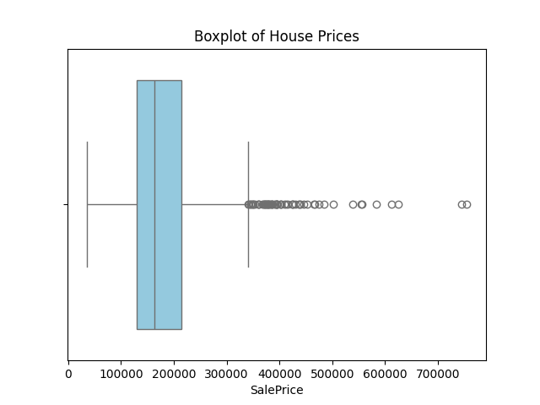
Customer Preferences and Amenities
Explanation of investigating customer preferences and amenities:
Customer preferences and amenities play a crucial role in influencing house prices. Understanding which amenities have the most significant impact can help in pricing strategies and property marketing.
The bar chart above illustrates the relationship between different amenities and house prices. By analyzing this chart, we can identify which amenities are highly valued by customers and contribute the most to property value.
This analysis enables real estate professionals to focus on enhancing or highlighting key amenities during property listings and negotiations, thereby maximizing property value and attracting potential buyers.

Slide 11
THANK YOU

